Slide 1
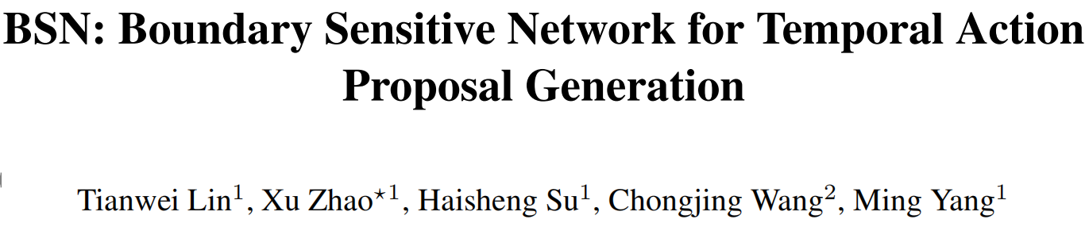
ECCV2018

Slide 2
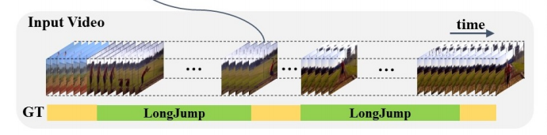
TAD(temporal action detection)
Step-1: locate the temporal proposal(start,end,score)
Step-2: action classification

Slide 3
How to get temporal proposal?
Top-down: Sliding Window + boundary regression
1.no temporally precise
2.not flexible enough to cover temporal durations with large range
Buttom-up: BSN

Slide 4
dataset

Slide 5
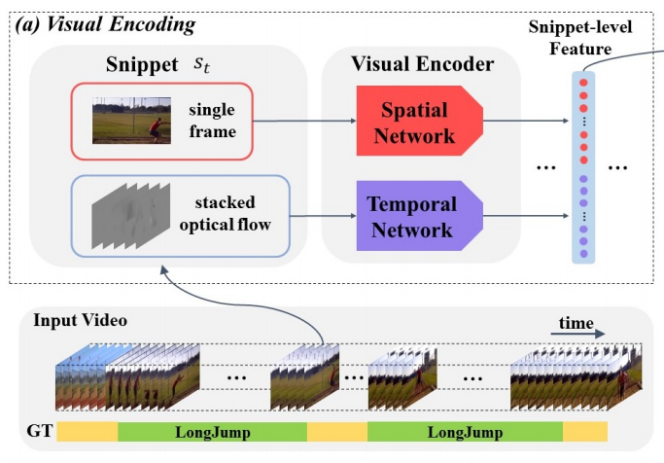
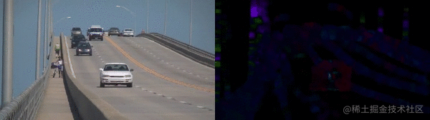
Preparation
TSN pre-trained on ActivityNet1.3(train)
RGB:{t}
(n_frames/5, 400)
Flow:{t-2,t-1,t,t+1,t+2}
(16 for ActivityNet1.3)
400(200+200)

Slide 6
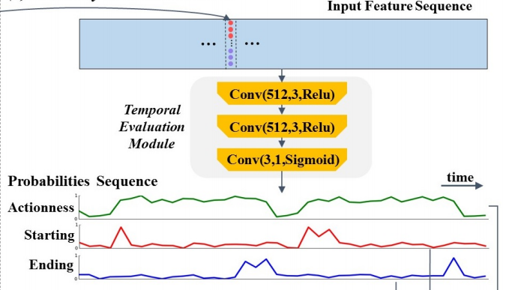
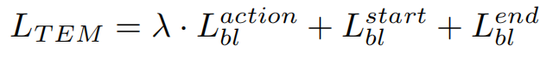
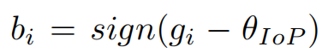
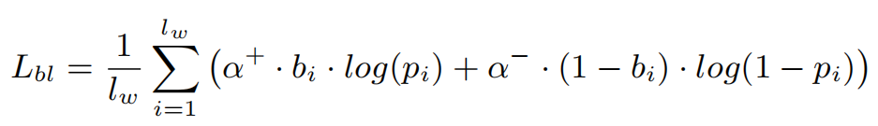
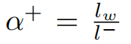
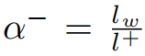
TEM(Temporal Evaluation Module)
ActivityNet1.3: (100, 400)
THUMOS14: sliding window 100
ground truth:
1000
50
50
new ground truth:
1000
IoP: 15/16
50
16
2
0.5
100
100

Slide 7
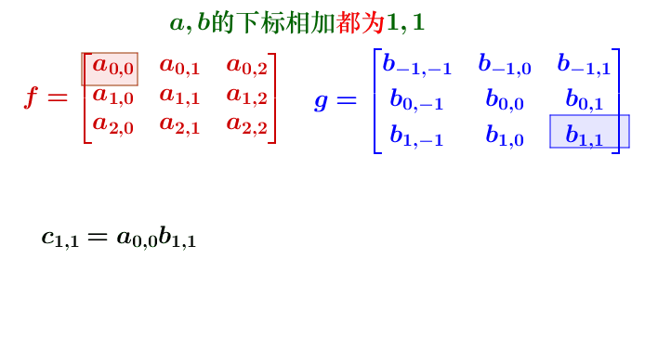
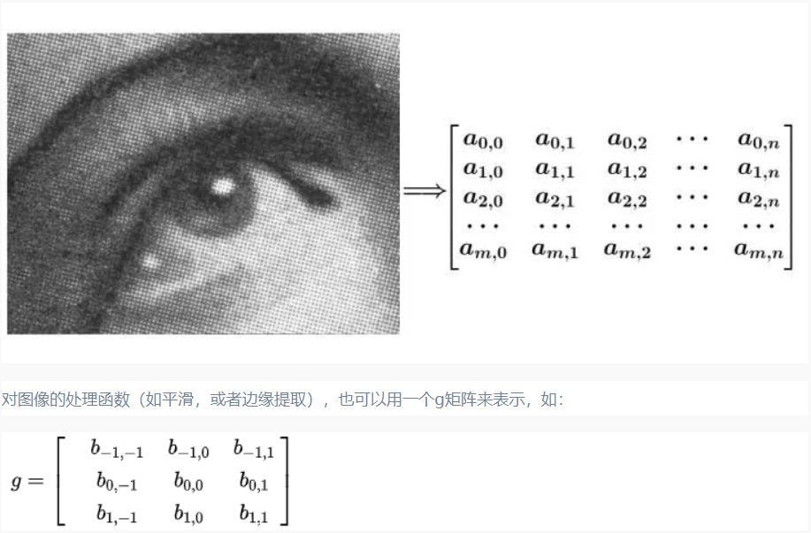

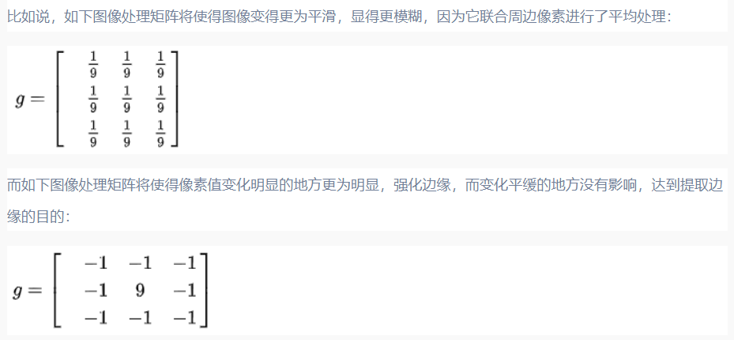
Convolution

Slide 8
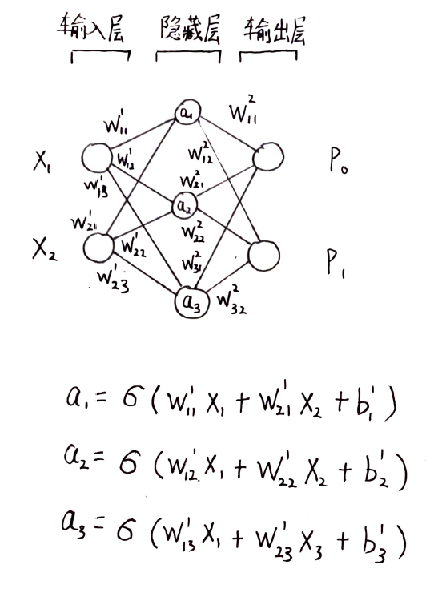
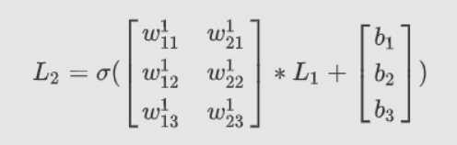
MLP(Multilayer Perceptron)

Slide 9
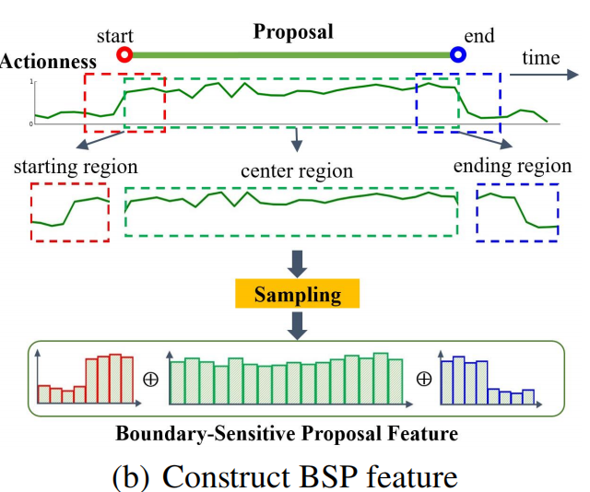
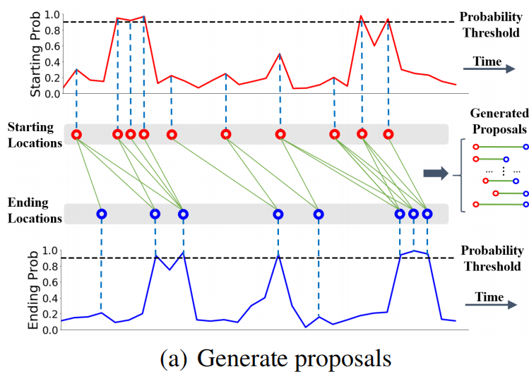
PGM(Proposal Generation Module)
use starting/ending probabilites sequences to generate proposals
sample actionness probabilities sequence by linear interpolation

Slide 10
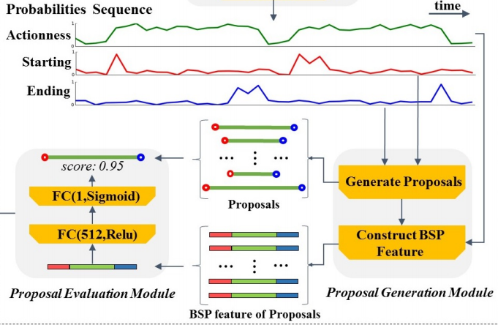
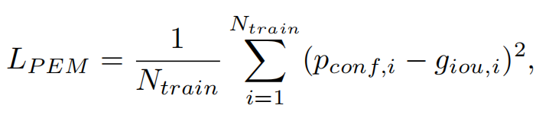
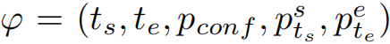
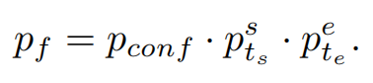
PEM(Proposal Evaluation Module)
a multilayer perceptron model
1:2 for data balancing

Slide 11
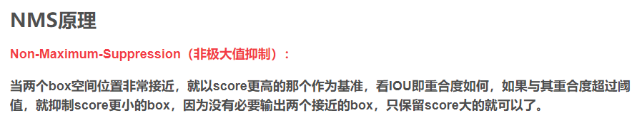
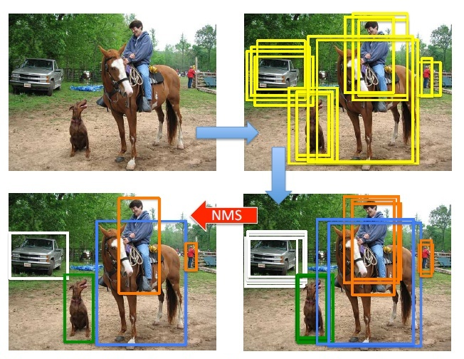
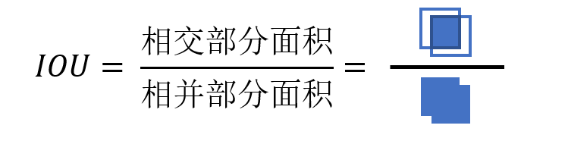
NMS

Slide 12
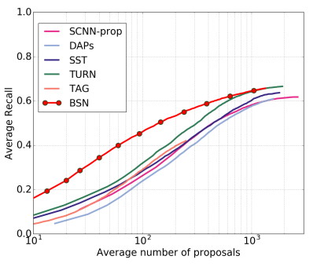
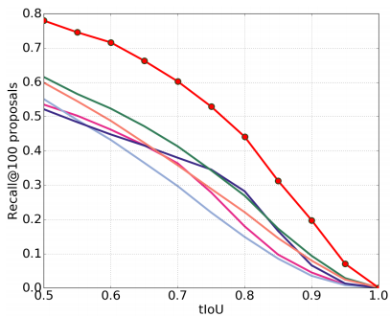
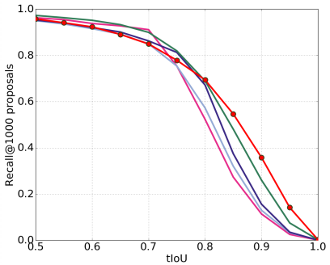
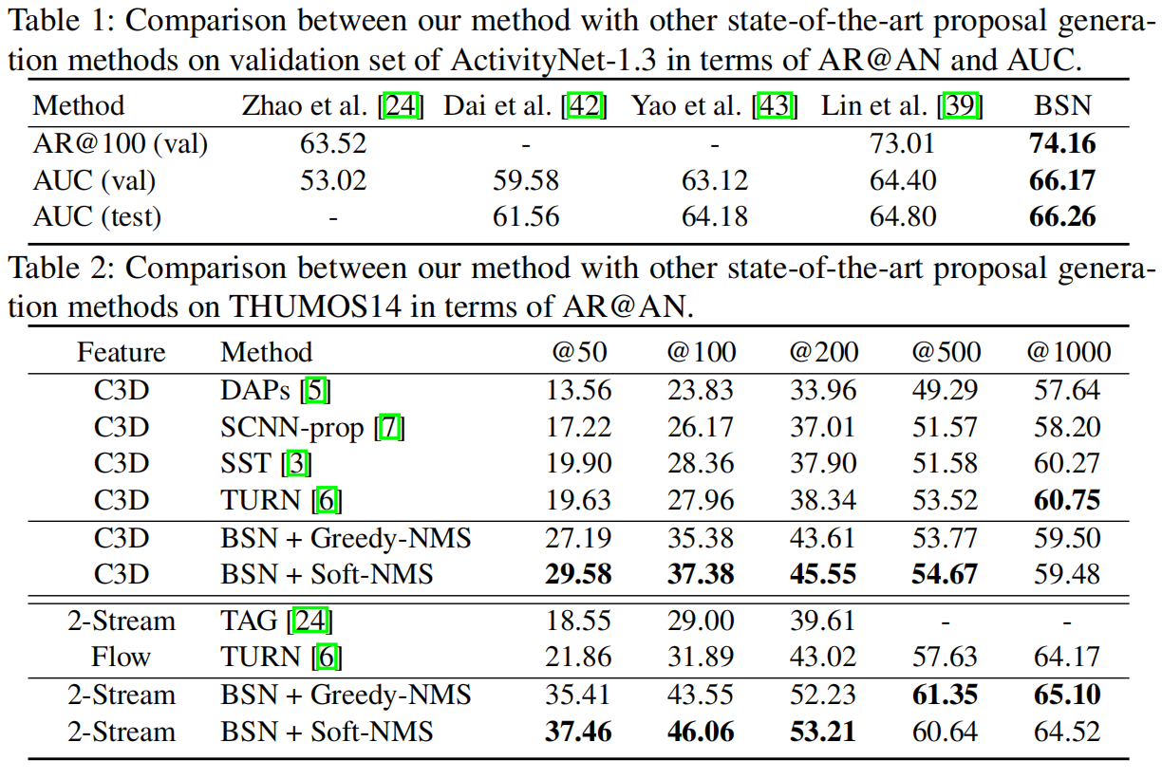
Average Recall

Slide 13
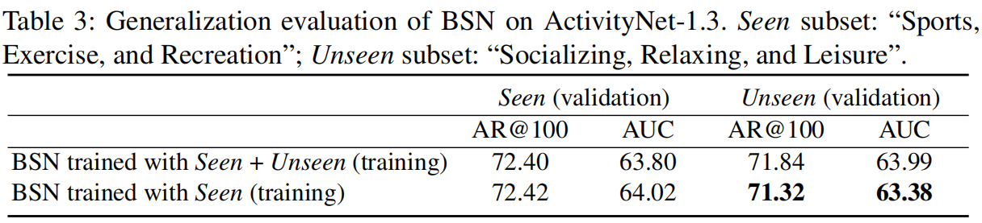
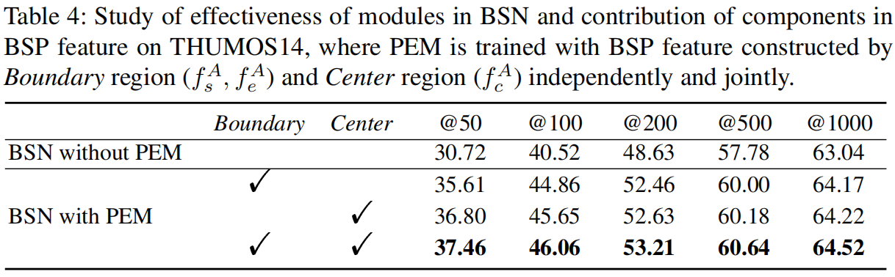
Generalization & Ablation Study

Slide 14
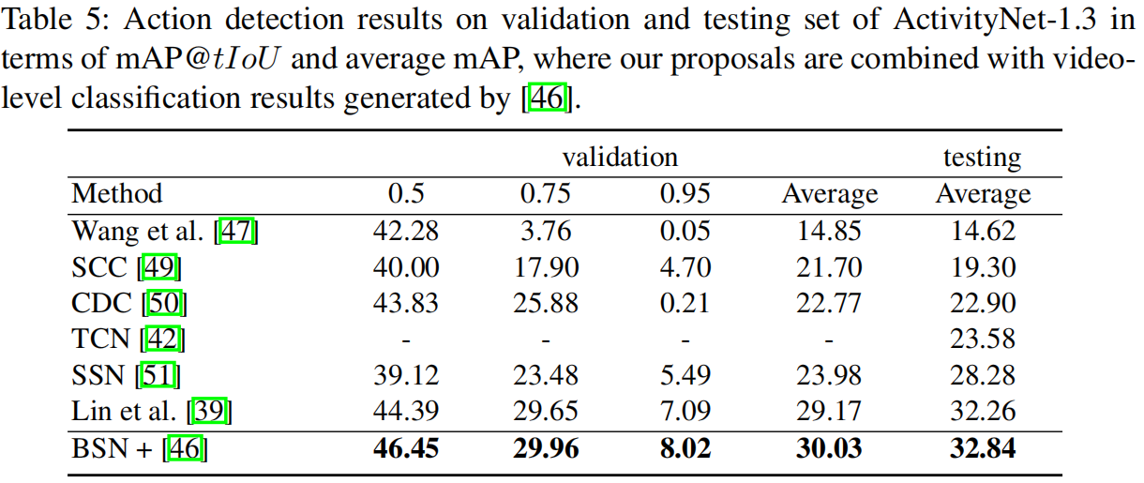
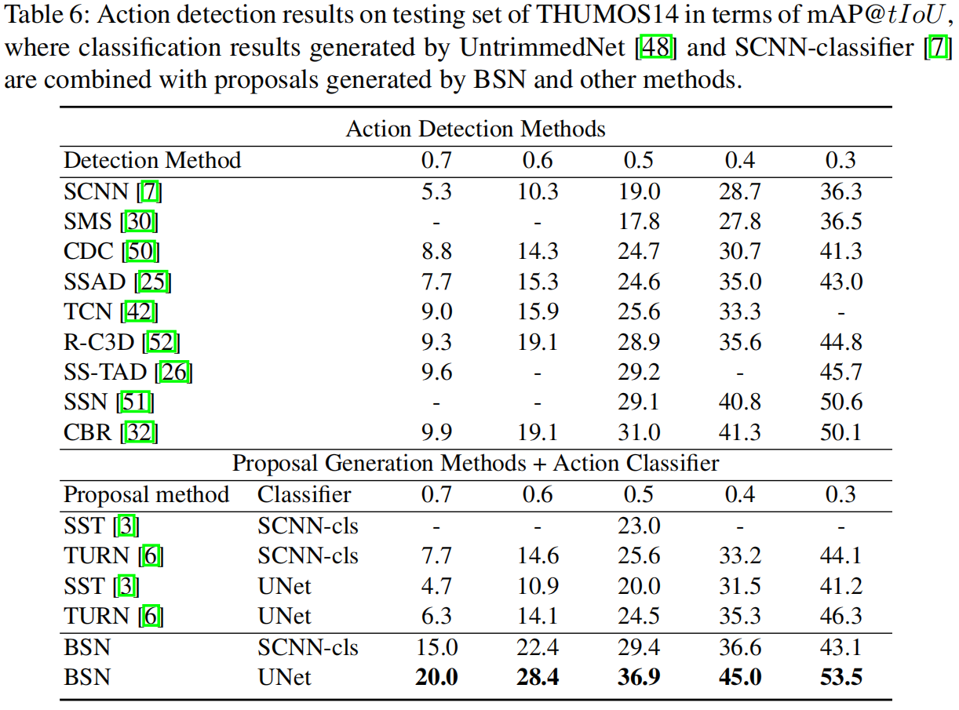
Action Detection

Slide 15
Future Work
TEM:
better feature
smaller snippet
relationship between snippet
PEM:
use snippet feature
size regression

